Slide 1
Pharmaceutical sales prediction across multiple stores
Presented By
Vivek Rajput

Slide 2
Objectives:
Rossmann operates over 3,000 drug stores in 7 European countries. Currently, Rossmann store managers are tasked with predicting their daily sales for up to six weeks in advance. Store sales are influenced by many factors, including promotions, competition, school and state holidays, seasonality, and locality. With thousands of individual managers predicting sales based on their unique circumstances, the accuracy of results can be quite varied.
In their first Kaggle competition, Rossmann is challenging you to predict 6 weeks of daily sales for 1,115 stores located across Germany. Reliable sales forecasts enable store managers to create effective staff schedules that increase productivity and motivation. By helping Rossmann create a robust prediction model, you will help store managers stay focused on what’s most important to them: their customers and their teams!

Slide 3
Pharmaceutical sales forecasting
Accurate sales forecasting is a crucial and affordable strategy to boost earnings, which will also lessen the impact of risks on key business operations. Modeling the ideal environment for the manufacture and distribution of goods is made possible based on the outcomes of the constructed forecast. The forecasting model serves as both the foundation for calculating the precise values that represent the anticipated result, or breakeven sales, and a functional and adequate representation of the process under investigation [1]. Figure 1 shows the stages of the prediction model.
Forecasting can be categorized into two types: qualitative and quantitative. Quantitative forecasting makes predictions from numerical data and historical events using probability calculations. There are two different types of forecasting: qualitative and quantitative. Using probability calculations, quantitative forecasting generates forecasts based on numerical data and past events, impacts and has long-term effects. The foundation for the models’ methodology is a mathematical model and an objective analysis. In contrast to quantitative forecasting, which only uses numbers, qualitative forecasting uses expert judgment. It is crucial to have knowledge of highly skilled professionals in this industry. Comparing this to qualitative forecasting is very different. When an abnormality can be anticipated, this strategy is employed. It works well when it is anticipated that future results will differ from those of the past

Slide 4
Importing Necessary Modules
We are going to import few necessary python modules to create our model.
We will be importing the following modules:
Pandas — For data manipulation and analysis
Numpy — For array manipulation
Matplotlib.pyplot — For plotting graphs and visualising data
Seaborn — For high level visualisation
Re — For using Regular Expressions (RegEx)
Tensor Flow — For building our Neural Network

Slide 5
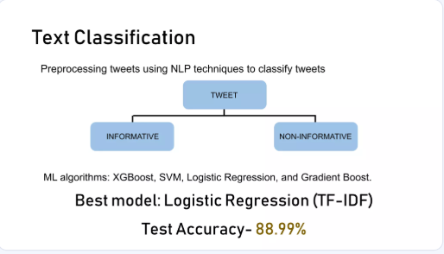
Text classification

Slide 6
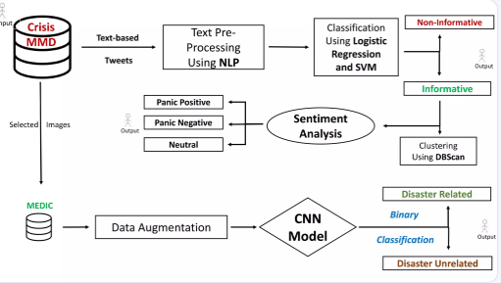
Flow chart

Slide 7
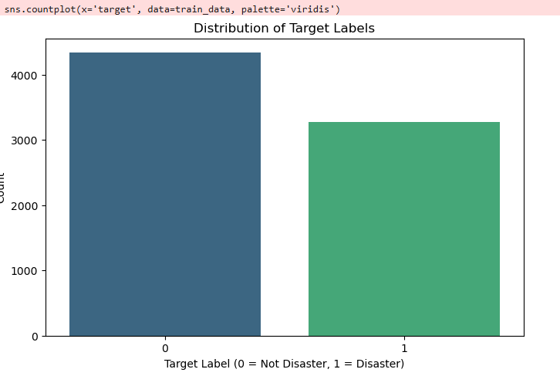
Data Distribution:

Slide 8
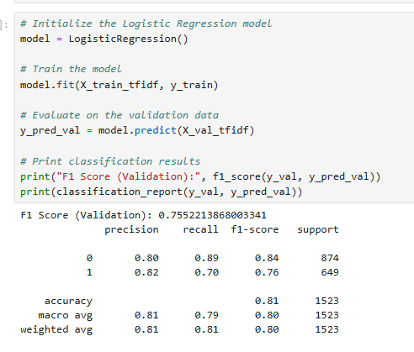
Machine Learning models for Parma Sales

Slide 9
Scope of Improvements
We can always use large dataset which covers almost every type of data for both machine learning and deep learning
We can use the best pertained models but they require a lot of computational power
Also there are various ways to increase model accuracy like k-fold cross validation, different data preprocessing techniques better than used here

Slide 10
Conclusion
The Data analysis and modelling was successfully done, and the Deep Learning model was deployed on Flask Web App
Please do the repository, if it helped you in anyway.
By successfully developing and deploying a machine learning model for classifying disaster related tweets, we can enhance the ability to detect and respond to emergencies more efficiently. This project represents a valuable opportunity to leverage NLP techniques for the greater good, contributing to the advancement of disaster management and public safety efforts.

Slide 11
Thank You

